Slide 1


TOPIC : AMQP
GM University
Davanagere
Group Number : 8
Presented By: Presented to:
Teerthashree H M Manoj P
Sowmya GM University
Sourav Davangere
Suhail
Notes:
GM University

Slide 2
CONTENTS
Introduction
Problem Statement
Implementation
Architecture
Working
Literature Survey
Advantages and Disadvantages
Applications
Conclusion
Conclusion

Slide 3
INTRODUCTION
What is AMQP?
AMQP stands for Advanced Message Queuing Protocol
It is an open-standard, message-oriented, and broker-based communication protocol.
Purpose
Designed for reliable, secure, and ordered message delivery.
Ensures that IoT data reaches its destination without loss.
Why used in IoT?
IoT systems generate continuous sensor data.
Needs guaranteed delivery, message routing, and acknowledgements.
Perfect for large-scale, industrial, and cloud-connected IoT systems.
Key Features
Supports message queuing, routing, publish–subscribe, and acknowledgments
Works asynchronously, suitable for high message traffic
Ensures interoperability across different devices and platforms
Where Used
Widely used in industrial IoT, smart city systems, cloud platforms, and enterprise IoT communication.

Slide 4
PROBLEM STATEMENT
“IoT systems generate large amounts of continuous data from sensors and devices. However, ensuring reliable, ordered, secure, and scalable communication between these devices and cloud applications is challenging.”
The problem is to identify and use a messaging protocol that:
Guarantees message delivery without loss
Works efficiently in large-scale IoT environments
Supports routing, queuing, and asynchronous communication
Provides security, interoperability, and scalability
AMQP is explored as a solution to these IoT communication challenges.

Slide 5
AMQP ARCHITECTURE
1️⃣ Producer (Sender)
IoT devices or applications that send sensor data
Example: temperature sensor sending readings
2️⃣ Message Broker
Central server that receives, stores, and routes messages
Manages queues and exchanges
Examples: RabbitMQ, ActiveMQ
3️⃣ Exchange
Component inside the broker that decides how to route messages
Types:
Direct Exchange – exact match
Topic Exchange – pattern-based routing
Fanout Exchange – broadcast to all queues
Headers Exchange – routing based on message metadata

Slide 6
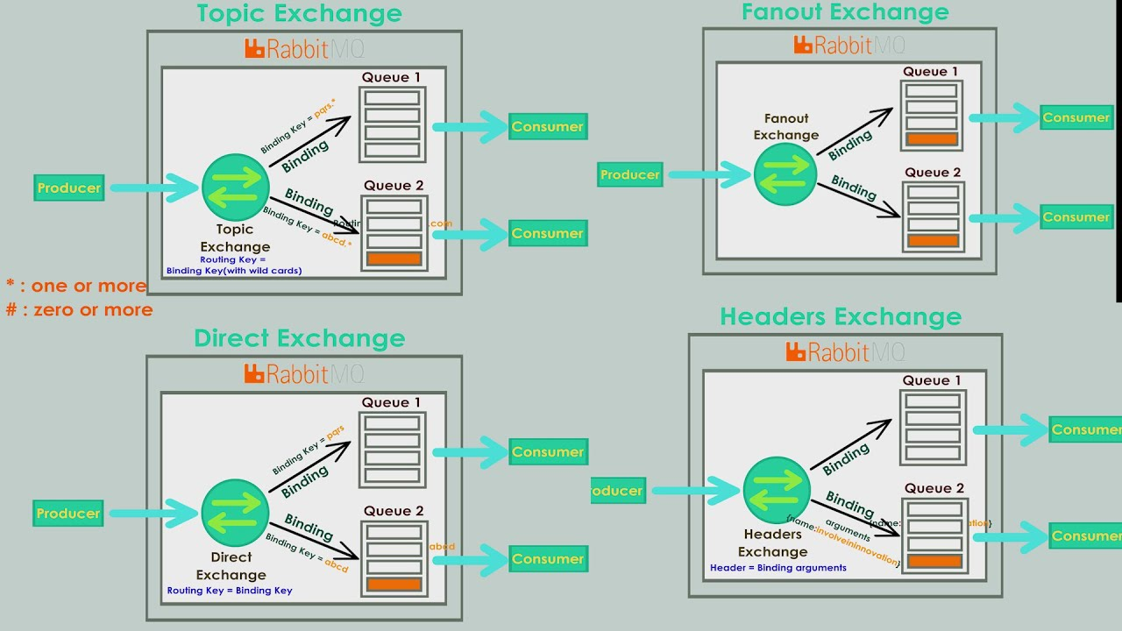
4️⃣ Queue
Temporary storage for messages until a consumer receives them
Ensures messages are not lost
5️⃣ Binding
Rule that connects Exchanges → Queues
Defines how messages get mapped to queues
6️⃣ Consumer (Receiver)
Applications or cloud services that receive messages
Example: IoT dashboard, data analytics system
7️⃣ Acknowledgements (ACK)
Consumer confirms message is received
Ensures reliable delivery
Prevents message loss or duplication

Slide 7
IMPLEMENTATION
1️⃣ Setup AMQP Broker
Install and configure RabbitMQ/ActiveMQ
Enable AMQP protocol and create users, permissions, and virtual hosts
2️⃣ Connect IoT Devices (Producers)
Sensors or Raspberry Pi send data
Use AMQP libraries in Python/Java/Node.js to publish messages
3️⃣ Create Exchanges & Queues
Define direct/topic exchanges
Bind queues using routing keys
Example: sensor_exchange → temperature_queue → temp.data

Slide 8
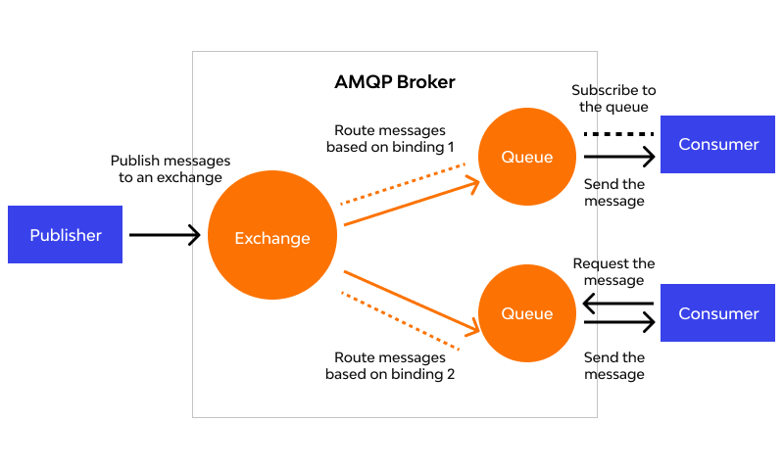
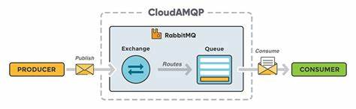
4️⃣ Setup Consumer Application
Cloud or local app listens to queues
Processes received IoT data
Sends ACK after successful delivery
5️⃣ Data Processing & Storage
Save data in MongoDB/MySQL/Firebase etc….
Visualize on dashboards
6️⃣ Testing & Validation
Check reliability and ordering
Test network failures and device failures

Slide 9
AMQP Frame Types
There are nine frame types in AMQP:
Open -Starts the connection between two systems.
Begin -Starts a messaging session.
Attach- Connects a link for sending or receiving messages.
Transfer- Sends the actual message.
Flow -Controls the speed of message flow.
Disposition- Confirms if the message was received or processed.
Detach -Removes the link between the systems.
End -Ends the messaging session.
Close- Closes the connection fully.

Slide 10
WORKING OF AMQP IN IoT
1️⃣ IoT Device Sends Data (Producer)
Sensor or device collects data
Sends message to the AMQP Broker
Example: Temperature sensor → sends reading
2️⃣ Message Reaches the Broker
Broker receives the message
Verifies, stores, and prepares it for routing
Examples of brokers: RabbitMQ, Azure IoT Hub, ActiveMQ
3️⃣ Exchange Processes the Message
Exchange decides how to route the message
Uses routing keys and rules
Exchange types: Direct, Topic, Fanout, Headers

Slide 11
4️⃣ Message Placed in the Correct Queue
Based on routing rules, the message is put into one or more queues
Queue temporarily stores message until a consumer fetches it
Ensures no message loss
5️⃣ Consumer Fetches the Message
Application, service, or analytics tool retrieves the message
For example: IoT dashboard displays data in real-time
6️⃣ Acknowledgement Sent (ACK)
Consumer sends ACK to broker
Confirms message is received successfully
Broker safely removes the message from the queue
7️⃣ Reliable & Ordered Delivery
If device or network fails, AMQP resends the message
Maintains order of messages
Guarantees exactly-once or at-least-once delivery

Slide 12
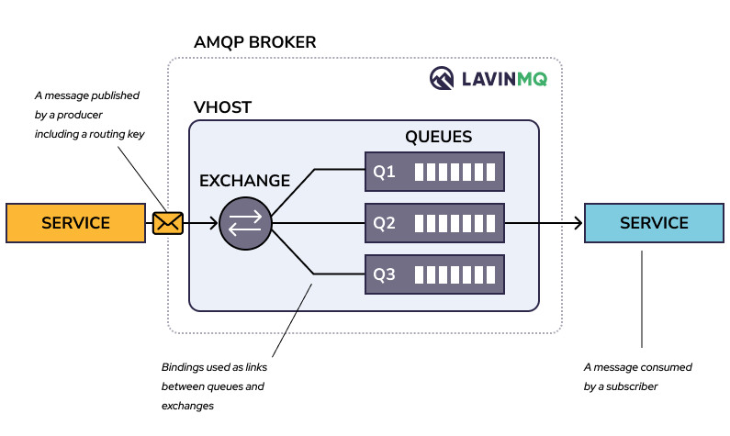

Slide 13
LITERATURE SURVEY
1️⃣ Previous research on IoT messaging protocols shows that AMQP provides strong reliability and message ordering, making it suitable for applications where accurate data transfer is critical (Author studies: IoT communication models, 2016–2020).
2️⃣ Studies comparing AMQP with MQTT, CoAP, and XMPP highlight that AMQP performs better in cloud-connected IoT systems due to its broker-based architecture, routing mechanisms, and secure message handling (Protocol evaluation research, IEEE papers).
3️⃣ Research on RabbitMQ and ActiveMQ implementations demonstrates that AMQP-based brokers can handle high message throughput, support clustering, and maintain stability under heavy IoT workloads, proving their suitability for industrial and smart city deployments (Performance analysis studies, 2018–2023).

Slide 14
ADVANTAGES OF AMQP
1️⃣ Guaranteed message delivery 2️⃣ Advanced routing options 3️⃣ High security 4️⃣ Cross-platform interoperability 5️⃣ Highly scalable 6️⃣ Supports asynchronous communication
DISADVANTAGES OF AMQP
1️⃣ Complex setup 2️⃣ High resource usage 3️⃣ Not suitable for low-power devices 4️⃣ Requires stable network 5️⃣ Broker dependency 6️⃣ Higher overhead than MQTT

Slide 15
APPLICATIONS OF AMQP IN IoT
1️⃣ Industrial IoT Monitoring
Machines send real-time status and fault alerts to the AMQP broker.
Helps factories monitor equipment, predict failures, and take quick action.
2️⃣ Smart City Traffic Management
Traffic sensors send vehicle count and signal data via AMQP.
The system routes this data to control centers to manage signals and reduce traffic congest

Slide 16
CONCLUSION
AMQP is a powerful and reliable messaging protocol that ensures secure, ordered, and guaranteed delivery of IoT data. Its advanced routing, interoperability, and scalability make it ideal for large and complex IoT systems. Although it requires more setup and resources, AMQP provides a strong communication backbone for industrial IoT, smart cities, cloud platforms, and real-time monitoring applications.
Overall, AMQP strengthens communication between devices and cloud services, improving system efficiency and decision-making. It continues to be a preferred choice for organizations that need dependable, structured, and intelligent IoT communication.

Slide 17
Thank you all

